Slide 1
Adversarial Attacks and Defences

Slide 2
Adversarial Attacks

Slide 3
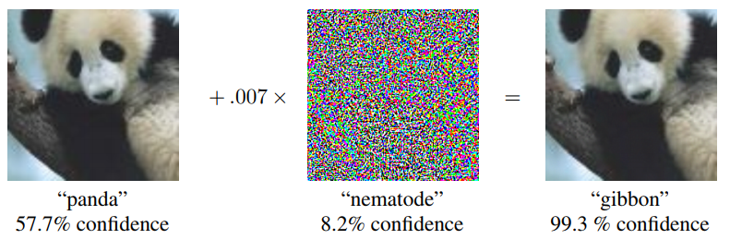
Adversarial Attacks[2013]
Explaining and Harnessing Adversarial Examples
Ian J. Goodfellow, Jonathon Shlens, Christian Szegedy
https://arxiv.org/abs/1412.6572

Slide 4
Adversarial Attacks

Slide 5
review
Adversarial Attacks and Defenses in Images, Graphs and Text: A Review
Han Xu, Yao Ma, Haochen Liu, Debayan Deb, Hui Liu, Jiliang Tang, Anil K. Jain
https://arxiv.org/abs/1909.08072
Adversarial Attacks and Defences: A Survey
Anirban Chakraborty, Manaar Alam, Vishal Dey, Anupam Chattopadhyay, Debdeep Mukhopadhyay
https://arxiv.org/abs/1810.00069
Adversarial Examples: Attacks and Defenses for Deep Learning
Xiaoyong Yuan, Pan He, Qile Zhu, Xiaolin Li
https://arxiv.org/abs/1712.07107

Slide 6
圖片分類[辨識] Image classification
訓練分類模型時，
網路基於輸入圖像學習特徵，
然後經過softmax層得到分類概率，
接著損失函數基於分類概率和真實標籤計算損失值，回傳損失值並計算梯度（也就是梯度反向傳播），
最後網路參數基於計算得到的梯度進行更新，
網路參數的更新目的是使損失值越來越小，
這樣模型分類正確的概率也就越來越高。
https://blog.csdn.net/u014380165/article/details/90723948

Slide 7
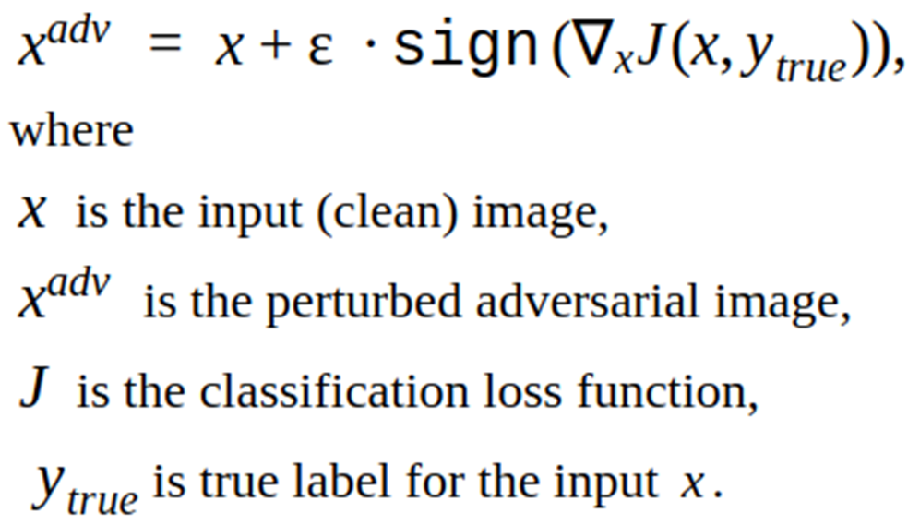
圖像攻擊 fast gradient sign method
圖像攻擊的目的是
不修改分類網路的參數，
而是通過修改輸入圖像的圖元值
使得修改後的圖像能夠
擾亂分類網路的分類，

Slide 8
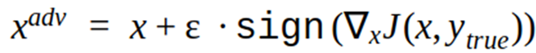
常規的分類模型訓練
在更新參數時都是將參數減去計算得到的梯度，
這樣就能使得損失值越來越小，從而模型預測對的概率越來越大。
攻擊:idea
希望模型將輸入圖像錯分類成正確類別以外的其他任何一個類別都算攻擊成功，
➔那麼只需要損失值越來越大就可以達到這個目標，
➔也就是模型預測的概率中對應於真實標籤的概率越小越好，
這和原來的參數更新目的正好相反。
只需要在輸入圖像中加上計算得到的梯度方向，
這樣修改後的圖像經過分類網路時的損失值就比修改前的圖像經過分類網路時的損失值要大，
換句話說，模型預測對的概率變小了。
這就是FGSM演算法的內容，一方面是基於輸入圖像計算梯度，另一方面更新輸入圖像時是加上梯度，而不是減去梯度，這和常見的分類模型更新參數正好背道而馳。

Slide 9
通過sign()函數計算梯度的方向
sign()函數是用來求數值符號的函數，
比如對於大於0的輸入，輸出為1，
對於小於0的輸入，輸出為-1，
對於等於0的輸入，輸出為0。
之所以採用梯度方向而不是採用梯度值是為了控制擾動的L∞距離，
讓我們的變化量與梯度的變化方向完全一致，那麼我們的誤差函數就會增大

Slide 10
權重參數
用來控制攻擊雜訊的幅值
參數值越大，攻擊強度也越大，
肉眼也更容易觀察到攻擊雜訊

Slide 11
範例: https://www.tensorflow.org/tutorials/generative/adversarial_fgsm
from __future__ import absolute_import, division, print_function, unicode_literals
import tensorflow as tf
import matplotlib as mpl
import matplotlib.pyplot as plt
mpl.rcParams['figure.figsize'] = (8, 8)
mpl.rcParams['axes.grid'] = False

Slide 12
載入the pretained MobileNetV2 model 及 the ImageNet class names.
tf.keras.applications
pretrained_model = tf.keras.applications.MobileNetV2(include_top=True,
weights='imagenet')
pretrained_model.trainable = False # 所有參數都不調整!!
# ImageNet labels
decode_predictions = tf.keras.applications.mobilenet_v2.decode_predictions

Slide 13
撰寫輸入圖片的處理函數Helper function
# Helper function to preprocess the image so that it can be inputted in MobileNetV2
def preprocess(image):
image = tf.cast(image, tf.float32)
image = image/255
image = tf.image.resize(image, (224, 224))
image = image[None, ...]
return image
# Helper function to extract labels from probability vector
def get_imagenet_label(probs):
return decode_predictions(probs, top=1)[0][0]

Slide 14
下載原始圖片並做預處理
tf.keras.utils.get_file
image_path = tf.keras.utils.get_file('YellowLabradorLooking_new.jpg', 'https://storage.googleapis.com/download.tensorflow.org/example_images/YellowLabradorLooking_new.jpg')
image_raw = tf.io.read_file(image_path)
image = tf.image.decode_image(image_raw)
image = preprocess(image)
image_probs = pretrained_model.predict(image)

Slide 15
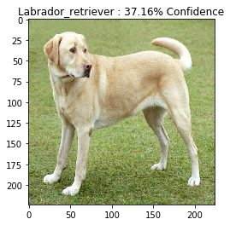
plt.figure()
plt.imshow(image[0])
_, image_class, class_confidence = get_imagenet_label(image_probs)
plt.title('{} : {:.2f}% Confidence'.format(image_class, class_confidence*100))
plt.show()

Slide 16
產生對抗樣本 adversarial image
建立擾動 create perturbations
loss_object = tf.keras.losses.CategoricalCrossentropy()
def create_adversarial_pattern(input_image, input_label):
with tf.GradientTape() as tape:
tape.watch(input_image)
prediction = pretrained_model(input_image)
loss = loss_object(input_label, prediction)
# Get the gradients of the loss w.r.t to the input image.
gradient = tape.gradient(loss, input_image)
# Get the sign of the gradients to create the perturbation
signed_grad = tf.sign(gradient)
return signed_grad

Slide 17
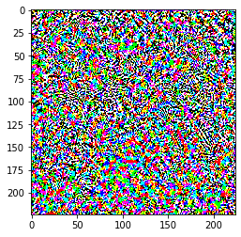
擾動 | perturbations
# Get the input label of the image.
labrador_retriever_index = 208
label = tf.one_hot(labrador_retriever_index, image_probs.shape[-1])
perturbations = create_adversarial_pattern(image, label)
plt.imshow(perturbations[0])

Slide 18
def display_images(image, description):
_, label, confidence = get_imagenet_label(pretrained_model.predict(image))
plt.figure()
plt.imshow(image[0])
plt.title('{} \n {} : {:.2f}% Confidence'.format(description,label, confidence*100))
plt.show()

Slide 19
epsilons = [0, 0.01, 0.1, 0.15]
descriptions = [('Epsilon = {:0.3f}'.format(eps) if eps else 'Input')
for eps in epsilons]
for i, eps in enumerate(epsilons):
adv_x = image + eps*perturbations
adv_x = tf.clip_by_value(adv_x, 0, 1)
display_images(adv_x, descriptions[i])
tf.clip_by_value(A, min, max)
輸入一個張量A，把A中的每一個元素的值都壓縮在min和max之間。
小於min的讓它等於min，
大於max的元素的值等於max

Slide 20
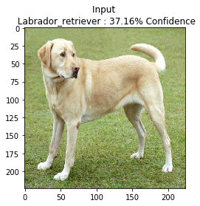
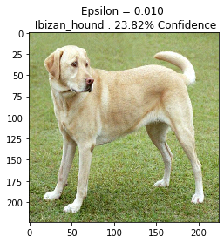
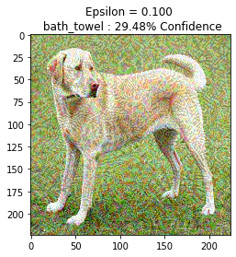
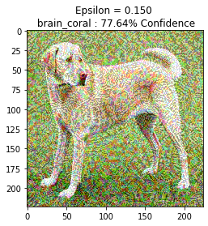

Slide 21

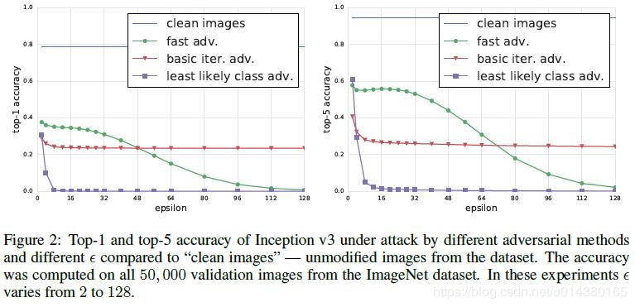
I-FGSM[2016]
Adversarial examples in the physical world
Alexey Kurakin, Ian Goodfellow, Samy Bengio
https://arxiv.org/abs/1607.02533
iterative FGSM
經典的單步攻擊，FGSM通過計算 cross-entropy loss的梯度來確定添加雜訊的方向。
I-FGSM將添加雜訊上限 分成幾步去添加，
每次反覆運算增加 雜訊增量。通過多步反覆運算添加雜訊。
I-FGSM是在目前所有的白盒場景下的反覆運算攻擊演算法中，攻擊效果最好的。這個演算法的一個主要缺點是反覆運算步數存在邊界效應。換句話說，隨著反覆運算次數的增加和每次反覆運算增加的雜訊增量的減少，在反覆運算次數增加到一定程度之後，再增加反覆運算次數對攻擊效果的提升很少。

Slide 22
Momentum iterative fast gradient sign method
https://arxiv.org/abs/1710.06081

Slide 23
cleverhans
https://github.com/tensorflow/cleverhans
import os
from cleverhans.attacks import FastGradientMethod
import numpy as np
from PIL import Image
from scipy.misc import imread
from scipy.misc import imsave
import tensorflow as tf
from tensorflow.contrib.slim.nets import inception
https://www.kaggle.com/benhamner/fgsm-attack-example/code

Slide 24
https://arxiv.org/pdf/1712.07107.pdf
L-BFGS Attack[2013]
Fast Gradient Sign Method (FGSM)[2014]
One-step Target Class Method (OTCM)
RAND-FGSM
Basic Iterative Method (BIM) and Iterative Least-Likely Class Method (ILLC)
Jacobian-based Saliency Map Attack (JSMA)
DeepFool
CPPN EA Fool
C&W’s Attack
Zeroth Order Optimization (ZOO)
Feature Adversary
One Pixel Attack
Hot/Cold method
Natural GAN
Model-based Ensembling Attack
Ground-Truth Attack

Slide 25
Adversarial Defences
Network Distillation
Adversarial (Re)training
Adversarial Detecting
Input Reconstruction
Classifier Robustifying
Network Verification
Ensembling Defenses

Slide 26
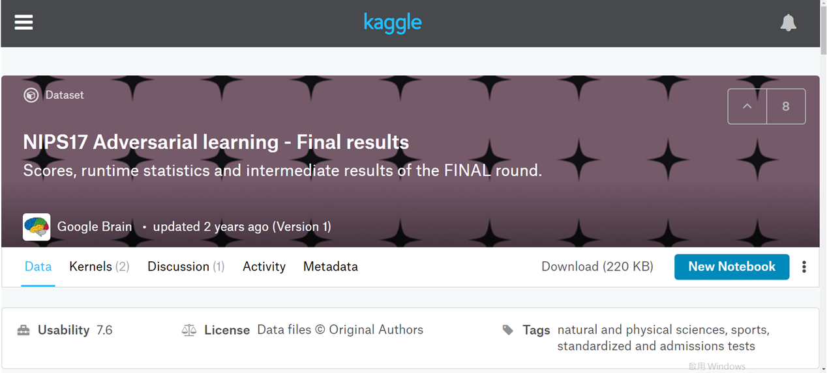
NIPS 2017 competition
https://www.kaggle.com/google-brain/nips17-adversarial-learning-final-results

Slide 27
Adversarial Defences

